Slide 1

Gesture and Sign Language
Assistance
Vulture
Bharati Vidyapeeth’s College of Engineering
Saarash
Pajrath

Slide 2



PROBLEM
1. Human beings interact with each other to convey their ideas, thoughts, and experiences to the people around them. But this is not the case for specially-abled people.
2. Sign Language is the most common mode of communication amongst specially-abled people.
3.The hand is one of the richest sources of communication, as we talk our hand automatically moves in accordance with the speech.
4. Loss of hearing and speech can cause people to be isolated and lonely, further worsening both their social as well as working life.
5. This problem calls for a system that can comprehend physical hand gestures based on static movements and bridge the communication gap between the normal and disabled.

Slide 3
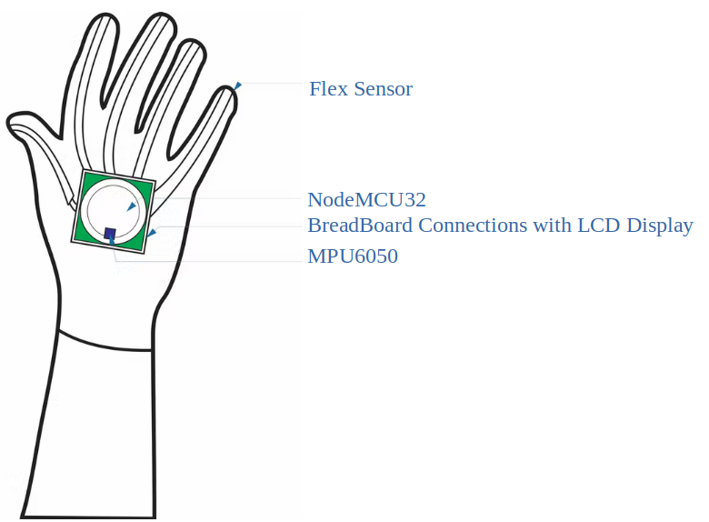
SOLUTION
From a viewpoint of specially-abled people who can move their fingers or toes, we have designed a glove that will assist.
Glove will not just help the specially-abled community but also the common people in controlling their appliances.
Developing a glove with gesture and sign language voice assistant which outputs data as per the input received.
Figure 1: Flex Sensor with Accelerator on Gloves

Slide 4
TECHNOLOGIES INVOLVED
1. Embedded Systems
2. Arduino Framework
3. I2C Protocol
4. Wi-Fi and BLE
5. IOT

Slide 5
COMPETITIVE ANALYSIS
1.

Slide 6
FEASIBILITY AND APPLICATIONS
1. Widely used by Specially- ablede people
2. Can be used by medical pat

